Slide 1

PROJECT PRESENTATION ON “ELECTRONIC INVENTORY BILLING SYSTEM”
Under the guidance
Of Mrs.Bomken kamdak
Bam Assistant professor, CSE
(computer science & engineering) RGU.
Presented By :
Bego Royi
Roll no:
18MCA018
Mca 6th semester

Slide 2
TABLES OF THE CONTENTS :
Title of the project.
Introduction.
Objective of the “Electronic inventory billing system”.
Technologies and tools.
Future scope of “Electronic inventory billing system”.
Feasibility analysis.
Conclusion.

Slide 3
TITLE OF THE PROJECT
ELECTRONIC BILLING SYSTEM.
INTRODUCTION :
The project “ Electronic inventory Billing System” is an application to automate the process of ordering and billing of a store. This web based application is designed considering the chain of electronic products which is located in various cities. This application also administrates its user and customers.

Slide 4
OBJECTIVE OF THE “ELECTRONIC INVENTORY BILLING SYSTEM” :
This project will serve the following objective :
Add and maintain records of available products.
Add and maintain customer details.
Add and maintain description of new products.
Add and maintain new entered category of products.
Provides economic/financial reports to the owner monthly or weekly and yearly.
Provides a convenient solution of billing pattern.
7. Make an easy to use environment for user and customers.

Slide 5
TECHNOLOGIES AND TOOLS :
SOFTWARE USED:
Languages used : PHP
Web browser : Google chrome
Database : MYSQL
notepad++(writing the program)
HARDWARE USED :
Processor : i5, i3 7th generation
Ram 4GB
Monitor : any monitor
Operating system : window XP, window 7, window 8 or any other version.

Slide 6
FUTURE SCOPE OF “ELECTRONIC INVENTORY BILLING SYSTEM” :
This project will help the store keeper in fast billing.
This project enables store keeper to maintain a great database of all customers visited and purchase product from stores.
Project will enable to see report regarding product and category.
It is easy to maintain in future prospect.

Slide 7
FEASIBILITY ANALYSIS :
Title : feasibility report for the computerization of the various activities of the company.
Background : The company facing the problem of inconsistent and out of time information in its activities. Very much time is consuming for report generation, which is not very helpful for decision making. So we want a system, which provide immediate information.

Slide 8
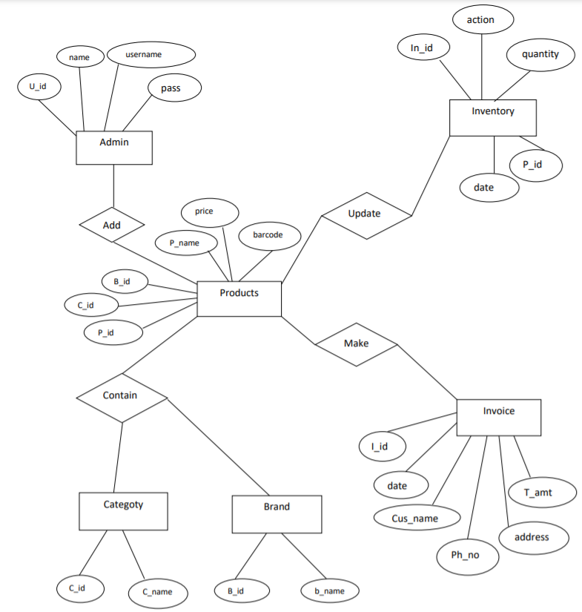
ER DIAGRAM

Slide 9
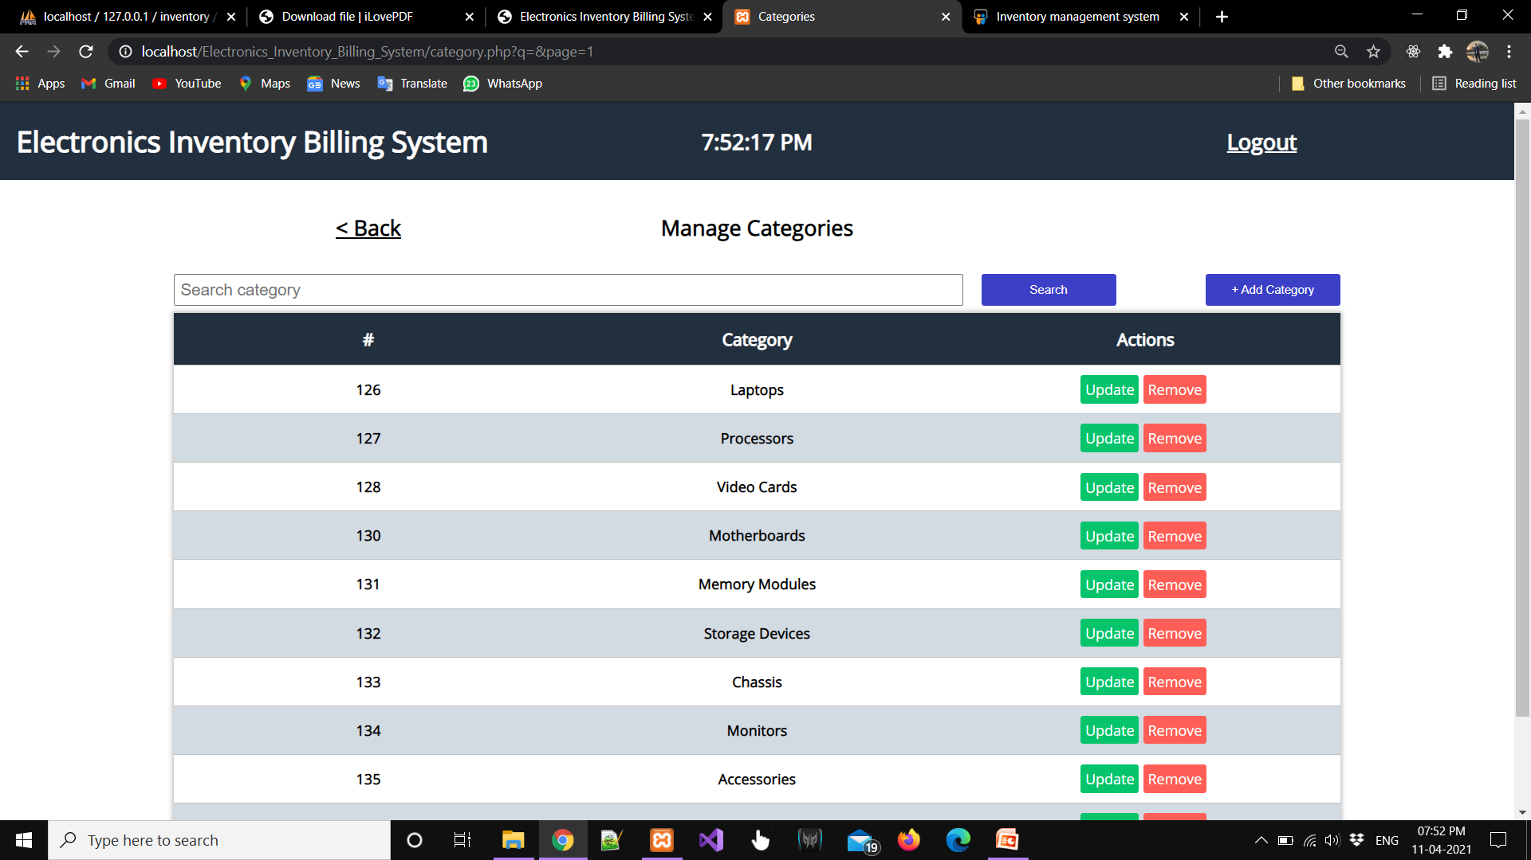
Add Category

Slide 10

Add Brand

Slide 11
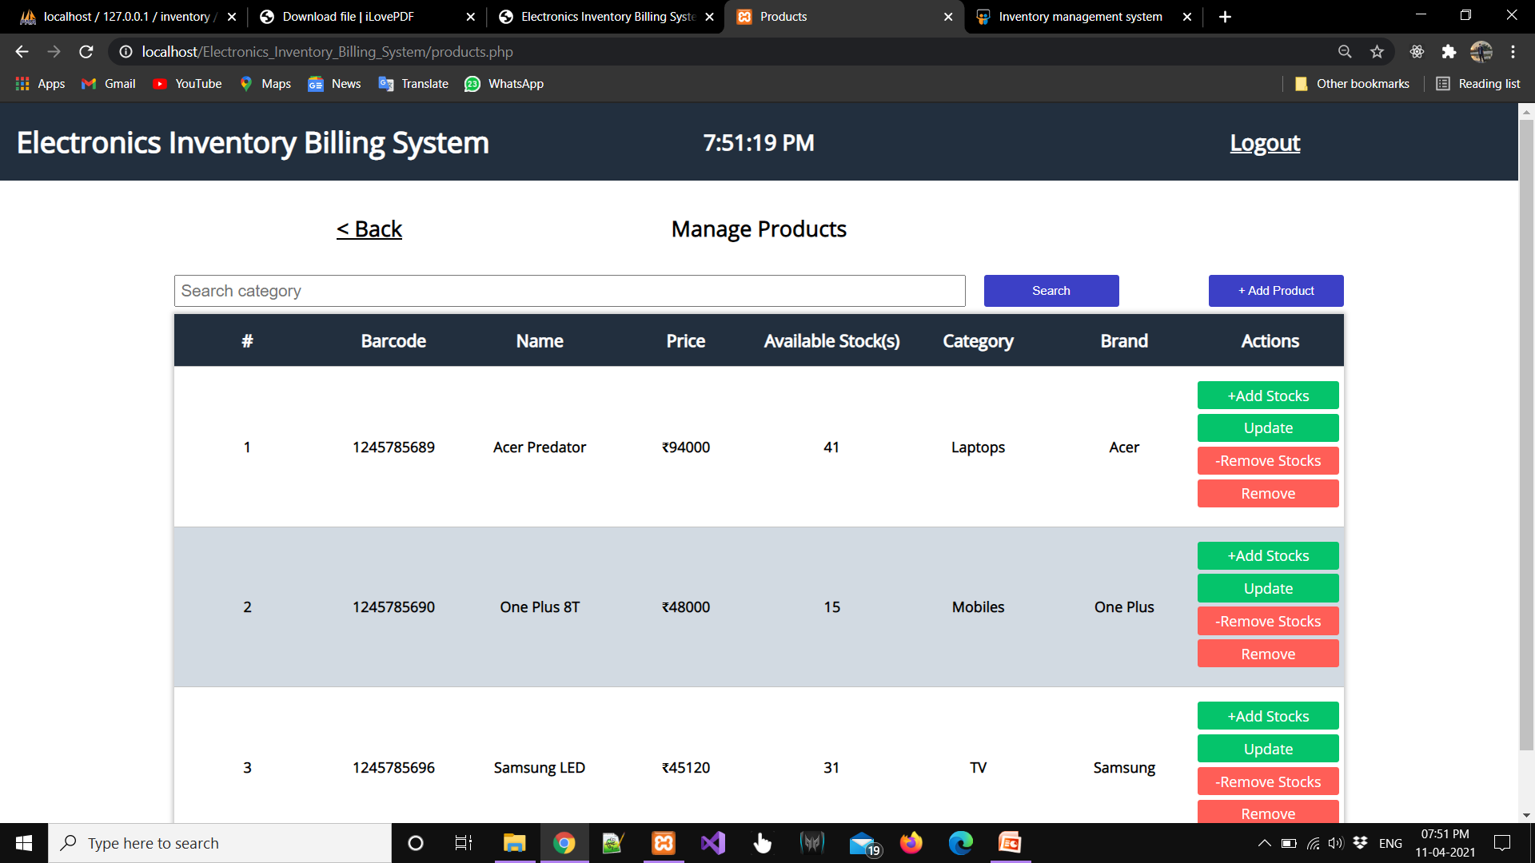
Add Products

Slide 12
CONCLUSION :
This is my project of system design about
“ Electronic inventory Billing system”. Development of this system takes a lot of efforts. I think this system gave a lot of satisfaction . Though every task is never said to be perfect in this development field even more improvement may be possible in this system.

Slide 13
THANKS

